Slide 1
INDIA’S CURRENT ACCOUNT DEFICIT (2016-2021)

Slide 2
INDEX
What is Current Account Balance ?
India’s External Sector Indicators
Snapshot – India’s Trade Balance
Trade Balance
India’s major trading partners
India‘s trade basket
Merchandise
Merchandise Exports
Merchandise Imports
Global Gold Market
India Gold Market
Invisibles
Services Trend
Software Exports
Private Transfers: Remittances
Summary
India’s FDI INFLOWS

Slide 3
WHAT IS CURRENT ACCOUNT BALANCE?
A summary record of transactions of Merchandise Trade and Invisibles (services+ transfers+ net income) of India with rest of the world.
It Includes 2 major items:
Merchandise Trade
Invisibles
Invisibles include:
Services – Software Exports & travel, transportation, tourism etc
Net Income - Income paid or received on investments like dividends, rents, interest etc
Transfers - Private Transfers (NRI remittances, gifts ) & official transfers (Grants, aids etc)
Current account deficit (CAD) is when payments exceed receipts from trade of goods & services, transfers and net income

Slide 4
India’s external sector indicators
-

Slide 5
INDICATORS | 2015-2016 | 2016-2017 | 2017-2018 | 2018-2019 | 2019-2020 | 2020-2021
GDP(at current prices, US$ bn) | 2148.4 | 2291.6 | 2626.4 | 2773.5 | 2889.0 | 2664.8
Exports(in bn$) | 262 | 276 | 303 | 330 | 313 | 291
Oil exports(in bn$) | 30 | 31.1 | 34.9 | 46.5 | 41.2 | 26.9
Non oil exports(in bn$) | 232 | 244.9 | 266 | 283 | 272 | 265.3
Imports(in bn$) | 381 | 382 | 465 | 514 | 474 | 393.
Oil imports(in bn$) | 82.9 | 86.9 | 108 | 140 | 130 | 82.6
Non oil imports(in bn$) | 298.1 | 295.8 | 356 | 373 | 344.1 | 310
Trade balance(in bn$) | (-)118 | (-)106 | (-)162 | (-)184 | (-)161 | (-)102
Services exports(in bn$) | 154.3 | 163.1 | 195.1 | 208.0 | 213.2 | 206.1
=> Software exports ( in bn$) | 76.6 | 76.3 | 79.8 | 86.3 | 96.1 | 100
Service imports ( in bn$) | 84.6 | 95.7 | 117.5 | 126.1 | 128.3 | 117.5
Service Balance ( in bn$) | 69.7 | 68.3 | 77.6 | 81.9 | 84.9 | 88.6
Current account Balance ( in bn$) | (-)22.1 | (-)14.4 | (-)48.7 | (-)57.2 | (-)24.6 | 23.9
=>CAB as percentage of GDP (%) | (-)1.1 | (-)0.6 | (-)1.9 | (-)2.1 | (-)0.9 | 0.9
FOREX RESEVES ( In bn$) | 360.2 | 370.0 | 424.5 | 412.9 | 477.8 | 579.3
EXTERNAL DEBT(In bn$) | 484.8 | 471.5 | 529.7 | 543.1 | 558.4 | 570.0
FDI INFLOWS(In bn$) | 55.6 | 60.2 | 61.0 | 62.0 | 74.4 | 82.0

Slide 6
INDIA’S FDI INFLOWS
Highest ever FDI inflows despite COVID19, registering a 9.8% jump at a time when global inflows have largely contracted.
Reflects the steps taken by the government for liberalizing the FDI regime. However, much of the increase was due to mergers and acquisitions compared to greenfield investment.
India’s outward investment has declined in recent years due to weak external demand and subdued investment climate

Slide 7
SNAPSHOT – INDIA’S TRADE BALANCE

Slide 8
India’s trade balance
Year | Exports( USD BN) | Imports (USD BN) | Total trade | Trade balance
2015-16 | 262 | 381 | 643 | (-)118
2016-17 | 276 | 382 | 658 | (-)106
2017-18 | 303 | 465 | 768 | (-)162
2018-19 | 330 | 514 | 844 | (-)184
2019-2020 | 313 | 474 | 787 | (-)161
2020-21 | 291 | 393 | 684 | (-)102
India’s total trade peaked at US$ 844 bn in 2018-19 following which it has continued to decline due to weak external demand in 2019-20. In 2020-21, the merchandise trade further declined due to the COVID-19 pandemic and stood at US$ 684 bn.
India’s merchandise trade to GDP ratio has declined from 30.8% in 2018-19 to 26.2% in 2020-21.
Oil and Gold are the two major component of India’s trade and therefore Merchandise goods (both exports and imports) can be further segmented into 3 major categories:
Oil related
Gold related
Non-Oil Non-Gold related

Slide 9
Major Exports and imports
Exports
Imports
India ranks among world-leading countries exporting diamonds, jewelry and refined petroleum.
India’s biggest export products by value in 2020 were refined petroleum oils, diamonds, pharmaceuticals, jewelry and cars. In aggregate, those major exports account for almost one third of the India’s overall exports sales. The commodities themselves suggest a relatively diversified range of exported goods.
46.9% of India’s exports by value were delivered to fellow Asian countries while 20.1% were sold to North American importers. India shipped another 18.7% worth of goods to Europe. Smaller percentages went to Africa (9.5%), Latin America excluding Mexico but including the Caribbean (3.4%) then Oceania led by Australia (1.5%).
India imported US$368 billion worth of goods from around the globe in 2021, up by 3.2% since 2016 but down by -23.2% from 2019 to 2020.
India’s biggest import products by value in 2020 were Mineral fuels including oil, Electrical machinery, Gems, precious metals, Machinery including computers, Organic chemicals, Plastics/ plastic articles, Animal/vegetable fats, oils, waxes Optical/technical/medical apparatus, Iron, steel,Fertilizers
62% of India’s total imports by value in 2020 were purchased from fellow Asian countries. European trade partners supplied 15.9% of import purchased by India while 8.8% worth originated from North America with another 7.5% coming from exporters in Africa. Smaller percentages arrived in India from Latin America (3.7%) excluding Mexico but including the Caribbean, and Oceania (2.1%) led by Australia.

Slide 10
India’s major trading partners

Slide 11
India’s trade basket

Slide 12
MERCHANDISE

Slide 13
Merchandise exports
FINANCIAL YEAR | OIL EXPORTS (US BN$) | %OIL | JEWELLERY&GEMS (US BN$) | %JEWLLERY&GEMS | NON-OIL NON-JEWELLERY (US BN$) | %NON-OIL NON-JEWELLERY | TOTAL (US BN$)
2015-2016 | 30 | 11.4 | 39.29 | 14.99 | 192.71 | 73 | 262
2016-2017 | 31.1 | 11.2 | 43.2 | 15.65 | 201.7 | 73.07 | 276
2017-2018 | 34.9 | 11.5 | 41.54 | 13.7 | 226.56 | 74.77 | 303
2018-2019 | 46.5 | 14 | 40.19 | 12.17 | 243.31 | 73.7 | 330
2019-2020 | 41.2 | 13.1 | 35.89 | 11.4 | 235.91 | 75.37 | 313
2020-2021 | 26.9 | 9.2 | 26.1 | 8.9 | 2380.8 | 81.7 | 291.08
India’s merchandise exports after peaking at US$ 330 billion in 2018-19, witnessed a contraction of 5.1% in 2019-20. It declined further by 7.1% in 2020-21.
Petroleum products (Oil), valued at 26.9bn$, formed 9.2% of India’s total exports in FY21.
Gems & Jewellery (Gold), valued at 26.1bn$, formed 8.9% of India’s total exports in FY21

Slide 14
MERCHANDISE EXPORTS: NON-OIL NON-GOLD
FINANCI-AL YEAR | EXPORTS (USD BN$) | ENGINEERI-NG EXPORTS (USD BN$) | %ENGINEERI-NG EXPORTS | TEXTILES AND HANDICRAFTS (USD BN$) | %TEXTILES AND HANDICRAFTS
2015-2016 | 262 | 58.6 | 22.3 | 38.98 | 15
2016-2017 | 276 | 65.2 | 23.6 | 39.91 | 14.1
2017-2018 | 303 | 76.2 | 25.14 | 39.29 | 12.9
2018-2019 | 330 | 81 | 24.54 | 40.36 | 12.2
2019-2020 | 313 | 75.34 | 24.07 | 36.94 | 11.8
2020-2021 | 291.08 | 73.11 | 25.11 | 36.4 | 12.5
Engineering goods valued at 73.11bn$ formed a major 25% of India’s total exports in 2021.
However, due to downfall faced by our economy due to the covid-19 pandemic and the disruption in supply chain engineering goods that grew by 6.2% from FY2017-18 to 2018-19, instead declined by 7% in FY2019-2020.
Textile and Handicrafts valued at 36.4 bn$ form another significant 12.5% of India’s total exports.
However, again owing to the pandemic, textile exports declined by another 8% from FY2018-19 to 2019-200.
From being worlds 2nd largest textile exporter in 2015, India moved down to 5th.

Slide 15
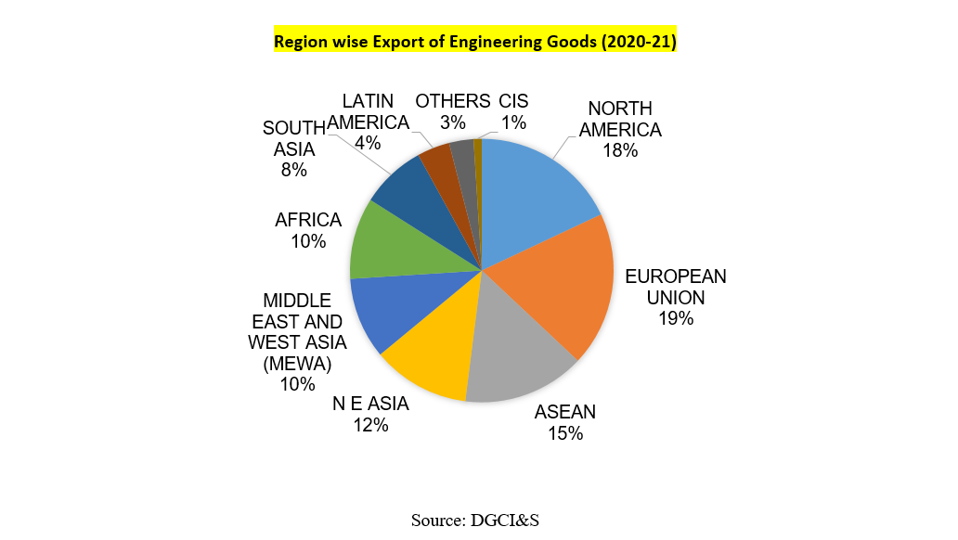

Slide 16
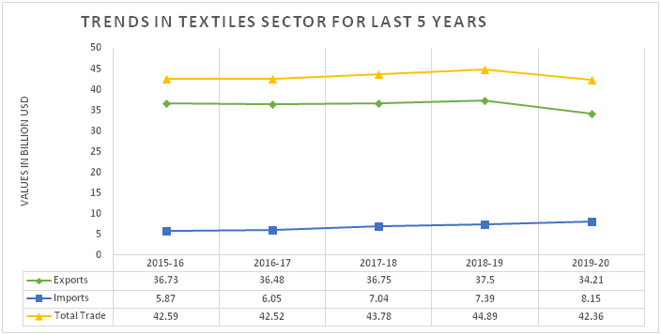
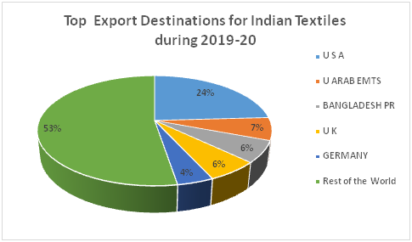
TEXTILE EXPORTS

Slide 17
MERCHANDISE EXPORTS – OUTLOOK FY2021-2022
OIL AND JEWELLERY EXPORTS
After years of continued growth, OIL exports took a decline in 2019-20, and continued to reach rock bottom in 2020-21. Oil exports are valued at 18.9bn$ during FY21-22(till July) assuming exports are stable, oil exports are expected to hit 50bn$ in FY22, 46% increase from FY21.
Due to the stiff competition from the Chinese exporters, Jewellery exports took a decline of 3% from FY 2016-17 to FY2017-18. With the addition of the Covid-19 pandemic, Jewellery exports fell to 26.1(US)bn$ in 2020-2021, lowest in a decade.
Jewellery exports during FY2021-22 are valued at 26.04(US) bn$(till NOV-21) assuming exports are stable, jewellery exports are expected to hit 39(US)bn$, 50% increase from FY2020-21.
ENGINEERING AND TEXTILES EXPORTS
EEPC projects engineering exports to hit 107 bn$ due to exponential growth of heating, ventilation, air-conditioning and refrigeration (HVAC-R) segment.
Textile exports are expected to stabilize in FY22 as GOVT. continues the Rebate of State and Central Taxes and Levies scheme. In addition to that India continues to ramp up its production of PPE kits and completely opened up exports of PPE kits.
Further, to boost exports in the textile sector, the Government has removed anti-dumping duty on PTA (Purified Terephthalic Acid), a key raw material for the manufacture of MMF fibre and yarn.
Centre has set a target of $44 billion worth of exports for the textile sector for FY22, 20% increase from FY21.Textile exports during April – December21, were valued at 29.8bn$ i.e 67% of the set target has been achieved.

Slide 18
MERCHANDISE EXPORTS – EXPECTATIONS FY22
 | FY 2020-21(US BN$) | FY 2021-22 (US BN$) | GROWTH(%)
PETROLEUM PRODUCTS | 26.9 | 50 | 46%
GEMS AND JEWELLERY | 26.1 | 39 | 50%
ENGINEERING GOODS | 73.11 | 107 | 46
TEXTILES | 36.4 | 44 | 20
OTHER | 150.49 | 160 | 6
TOTAL EXPORTS | 313 | 400 | 27
IBEF Projects Merchandise exports to grow from 313bn$ to 400bn$ IN FY2021-22.

Slide 19
MERCHANDISE IMPORTS
FINANCIAL YEAR | OIL (US BN$) | %OIL | JEWELLERY AND GEMS (US BN$) | %JEWELERRY AND GEMS | NON-OIL NON-JEWELLERY(US BN$) | %NON-OIL NON-JEWELLERY
2015-16 | 82.9 | 21.7 | 24.41 | 6.4 | 273.69 | 71.8
2016-17 | 86.9 | 22.7 | 28.8 | 7.5 | 266.3 | 69.71
2017-18 | 108 | 23.22 | 31.69 | 6.8 | 325.31 | 69.9
2018-19 | 140 | 27.2 | 26.57 | 5.1 | 347.43 | 67.5
2019-20 | 130 | 27.4 | 24.53 | 5.1 | 319.47 | 67.3
2020-21 | 82.6 | 20.9 | 16.49 | 4.1 | 294.91 | 74.8
Imports contracted more than exports due to weaker domestic demand, especially for the intermediate and capital-intensive goods. India’s imports therefore declined by 17.1% in 2020-21 after declining by 7.7% in 2019-20.
Overall, India’s trade deficit during 2020-21 stood at US$ 103 bn narrowing from US$ 161 bn in 2019-20 leading to a current account surplus of US$ 24 bn (0.9% of GDP) in 17 years.

Slide 20
India’s Crude Oil Import – Outlook FY-22
 | 2015-16 | 2016-17 | 2017-18 | 2018-19 | 2019-20 | 2020-21
Q-1 ($ bn) | 23.3 | 19.01 | 21.6 | 33.3 | 32.7 | 13.2
Q-2 ($ bn) | 22.7 | 20.44 | 22.3 | 35.3 | 28.05 | 18.6
Q-3 ($ bn) | 19.6 | 21.8 | 27.7 | 39.6 | 30.2 | 21.4
Q-4 ($ bn) | 14.7 | 25.53 | 31.2 | 32.6 | 32.9 | 18.9
Total Crude Import ($ bn) | 80.3 | 76.78 | 102.8 | 140.8 | 123.85 | 72.1
Total Imports ($ bn) | 381 | 382 | 465 | 514 | 474 | 393
%age of total Imports | 21 | 20 | 22.1 | 27.3 | 26 | 18.3
Average Price ($/bbl) | 43.29 | 50.29 | 65.23 | 56.99 | 39.68 | 68.17
Indian basket ($/bbl) | 46.17 | 47.56 | 56.43 | 69.88 | 60.47 | 48.94
381
According to the International Energy Agency (IEA), consumption of natural gas in India is expected to grow by 25 billion cubic metres (bcm), registering an average annual growth of 9% until 2024.
India imports nearly 85% of its crude requirements.
Key Indian oil retailers such as Bharat Petroleum and Hindustan Petroleum have announced plans to increase the capacity of their outlets in rural areas in 2021.
World bank projects crude oil prices to average around 74$/bbl, with increase in demand by 7%.
India’s import of palm oil fell by 29% in December 21 and vegetable oil fell by 10%.
India’s oil import is valued at 43.7bn$ during FY2021-22(till July), assuming trade to remain stable, oil imports are expected to hit 131.1bn$.

Slide 21

GLOBAL GOLD MARKETS

Slide 22
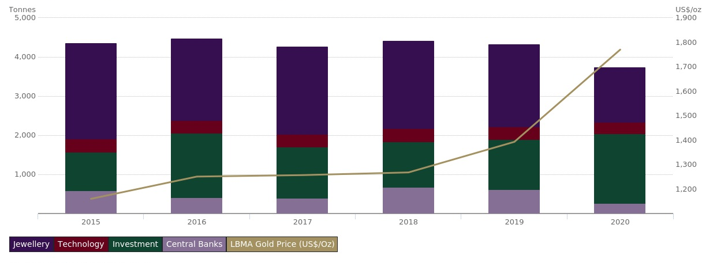
GLOBAL GOLD MARKETS
Demand for gold can be classified under Consumer Demand, Investment Demand & Industrial Demand.
Consumer Demand – Jewellery including Gold ornaments, Gold coins and Bars etc.
Investment Demand – ETFs, Central Bank Purchases.
Industrial Demand – Technology (Electronics, Pharma etc)
GLOBAL GOLD DEMAND BY CATEGORY(TONNES) AND THE GOLD PRICE (US$/OZ)

Slide 23
Global gold demand
 | JEWELLERY |  | BARS & COINS |  | ETF |  | TECHNOLOGY |  | CENTRAL BANK |  | TOTAL
YEAR | TONNES | US(BN$) | TONNES | US(BN$) | TONNES | US(BN$) | TONNES | US(BN$) | TONNES | US(BN$) | TONNES | US(BN$)
2015 | 2459.9 | 91.74 | 1091.4 | 40.7 | (-)112.6 | (-)4 | 331.7 | 12.3 | 579.6 | 21.6 | 4349.9 | 162.2
2016 | 2103.9 | 84.6 | 1073.1 | 43.1 | 582.0 | 23.4 | 323 | 12.9 | 394.9 | 15.8 | 4476.8 | 180
2017 | 2241.0 | 90.57 | 1043.9 | 42.2 | 265.7 | 10.7 | 332.6 | 13.4 | 378.6 | 15.3 | 4261.8 | 172
2018 | 2248.5 | 91.6 | 1090.3 | 44.4 | 83.0 | 3.3 | 334.8 | 13.6 | 656.2 | 26.7 | 4412.8 | 179
2019 | 2123.2 | 95 | 866.7 | 38.8 | 408.2 | 18.2 | 326 | 14.6 | 605.4 | 27.1 | 4329.4 | 193
2020 | 1401.1 | 79.7 | 899.6 | 51.17 | 873.9 | 49.7 | 302.2 | 17.1 | 255 | 14.5 | 3731.7 | 210
2021(till oct) | 1323.3 | 76.4 | 856.6 | 49.3 | (-)156 | (-)9 | 245.1 | 14.1 | 393.3 | 22.6 | 2662.5 | 154

Slide 24
GLOBAL “PHYSICAL” GOLD DEMAND
International gold prices have been rapidly increasing on a Y-O-Y basis and hits a decade high during Q2,FY21@ 1908.6$/oz.
Covid – 19 pandemic had a major negative impact on the global gold industry. The operations most adversely affected by the pandemic are underground mines in regions where currencies have not depreciated against the dollar.
Rise in cryptocurrency, NFT and other blockchain led “investments” during FY2020-21 has affected the global gold demand and even replaced it as a “ store of value”.
Jewellery + Bars + Coins +Technology (Tonnes)
 | FY2018-19 | FY2019-20 | FY2020-21
Q1 | 853.5 | 829.6 | 469.3
Q2 | 930.7 | 700.3 | 631.1
Q3 | 1020.9 | 913.5 | 863.5
Q4 | 872.4 | 639 | 917.1
JEWELLERY
 | FY 2018-19 |  | FY2019-20 |  | FY2020-21
 | TONNES | %AGE | TONNES | %AGE | TONNES | %AGE
Q1 | 522.2 | 66 | 529.8 | 63.8 | 244.5 | 52
Q2 | 547.9 | 58.8 | 469.0 | 66.9 | 332.9 | 52.7
Q3 | 649.3 | 63.6 | 589.2 | 84 | 510.3 | 59
Q4 | 535.2 | 61.3 | 313.5 | 48 | 484.1 | 52.7
BARS AND COINS
 | FY 2018-19 |  | FY 2019-20 |  | FY 2020-21
 | TONNES | %AGE | TONNES | %AGE | TONNES | %AGE
Q1 | 248 | 29 | 219.1 | 26.4 | 156.7 | 33.3
Q2 | 297.4 | 31.9 | 149.3 | 21.3 | 221 | 35
Q3 | 283.7 | 27.7 | 241 | 26.3 | 269.2 | 31.1
Q4 | 257.3 | 29.4 | 252.6 | 39.5 | 351.9 | 38.3

Slide 25
INDIAN GOLD MARKET
India’s official gold holding is 744.8 tonnes.

Slide 26
INDIA’S GOLD CONSUMPTION
 | FY 2018-19 |  |  |  |  |  | FY 2019-20 |  |  |  |  |  | FY 2020-21
 | JEWELLERY |  | BARS& COINS |  | TOTAL |  | JEWELLERY |  | BARS & COINS |  | TOTAL |  | JEWELLERY |  | BARS& COINS |  | TOTAL
 | USBN $ | TONNES | USBN$ | TONNES | USBN$ | TON-NES | USBN$ | TONNES | USBN$ | TONNES | USBN$ | TON-NES | USBN$ | TO-NES | USBN$ | TONNES | USBN$ | TONNES
Q1 | 6.2 | 149.9 | 1.6 | 39.3 | 7.8 | 189.2 | 7.1 | 168.6 | 1.8 | 44.5 | 8.9 | 213.1 | 2.4 | 44.0 | 1.1 | 19.8 | 3.5 | 63.8
Q2 | 5.8 | 148.8 | 1.3 | 34.4 | 7.1 | 183.2 | 4.8 | 101.6 | 1.1 | 22.3 | 5.9 | 123.9 | 3.7 | 60.8 | 2.1 | 33.8 | 5.8 | 94.6
Q3 | 7.1 | 180.1 | 2.2 | 56.4 | 9.3 | 236.5 | 7.1 | 149.0 | 2.1 | 45.3 | 9.2 | 194.3 | 8.2 | 137.3 | 2.9 | 48.9 | 11.1 | 186.2
Q4 | 5.2 | 125.4 | 1.4 | 33.6 | 6.6 | 159 | 3.7 | 73.9 | 1.4 | 28.1 | 5.1 | 102 | 5.9 | 102.5 | 2.1 | 37.5 | 8 | 140
India is the world's second-biggest gold consumer after China.
It is estimated that currently, approximately 25-26 refineries are active, with a combined refining capacity of 1,200- 1,400 tonnes.
Gold demand expected to decline in Q4,FY22 as surging covid cases trims luxurious Indian weddings.

Slide 27
INDIA’S GOLD IMPORT – OUTLOOK FY 2021-22
 | 2015-16 | 2016-17 | 2017-18 | 2018-19 | 2019-20 | 2020-21
GOLD BAR(USbn$) | 4.28 | 4.29 | 5.86 | 8.03 | 7.96 | 1.53
GOLD JEWELLERY (Usbn$) | 0.29 | 0.27 | 0.27 | 0.29 | 0.29 | 0.21
TOTAL GOLD IMPORT(US/bn$) | 24.41 | 28.8 | 31.69 | 26.57 | 24.53 | 16.49
HIGH PRICE ($/OZ) | 1192.4 | 1334.8 | 1329.3 | 1306.0 | 1582.8 | 1908.6
LOW PRICE ($/OZ) | 1106.5 | 1219.5 | 1256.6 | 1213.2 | 1303.8 | 1711.1
AVERAGE PRICE ($/OZ) | 1149.5 | 1277.15 | 1292.95 | 1259.6 | 1443.3 | 1809.85
As per a report by WGC, imports made up 86% of India's gold supply between 2016-2020
Gems and Jewellery Export Promotion Council (GJEPC) has urged the government to reduce import duty on gold to 4 per cent from 7.5 per cent in 2022.
Gold imports are valued at 38bn$ in FY2021-22(APRIL – DECEMBER).
Expect gold imports to reach 41bn$ in FY2022.

Slide 28
MERCHANDISE IMPORT EXPECTATION FY22
 | FY2020-21(US bn$) | FY 2021-22(Us bn$) | GROWTH(%)
Petroleum Crude | 72.1 | 131 | 80
Gold | 16.49 | 41 | 148
Electronic machinery | 46.6 | 52 | 11.5
Precious metal | 55.1 | 59 | 7
Coke, Coal & Briquettes | 20.5 | 24 | 17
Others | 182.1 | 265 | 45
Total Imports | 393 | 572 | 45
Expect Merchandise imports to grow 45% from 393bn$ in FY21 to 572bn$ in FY22.
ICEA requests the government to reduce import tariffs.

Slide 29

INVISIBLES

Slide 30
SERVICES TREND

Slide 31
SERVICES TRADE KEY COMPONENTS FY 2020-21
*Other business services include research & development services, professional & management consulting services and technical & trade related services.
*Other services include personal, cultural & recreational services, government goods & services, charges for using intellectual property, maintenance & repair services and manufacturing services.

Slide 32
SOFTWARE
 | RECIEPTS (US MN$) | PAYMENTS (US MN$) | NET (USMN$)
Q1 FY 2018-19 | 20,121 | 1,516 | 18,605
Q2 FY 2018-19 | 20,757 | 1,472 | 19,286
Q3 FY 2018-19 | 21,148 | 1,254 | 19,895
Q4 FY 2018-19 | 21,439 | 1,571 | 19,868
FY 2018-19 | 83,466 | 5,812 | 77,654
Q1 FY 2019-20 | 22,811 | 1,812 | 20,998
Q2 FY 2019-20 | 23,247 | 2,182 | 21,064
Q3 FY 2019-20 | 23,760 | 2,305 | 21,455
Q4 FY 2019-20 | 23,285 | 2,159 | 21,125
FY 2019-20 | 93,102 | 8,459 | 84,643
Q1 FY 2020-21 | 22,623 | 1,849 | 20,774
Q2 FY 2020-21 | 24,791 | 2,769 | 22,021
Q3 FY 2020-21 | 25,782 | 2,312 | 23,470
Q4 FY 2020-21 | 26,802 | 3,327 | 23,475
FY 2020-21 | 99,997 | 10,257 | 89,741
Software exports and imports grew by 7% and 20% respectively from FY20 TO FY21.
The ongoing Covid pandemic has accelerated the export momentum. In the last two years, global enterprises and people at large have adopted technology like never before. Digital transformation among businesses with migration to cloud is at all time high. Similarly, app-based digital interfaces have seen widespread adoption in recent years. This has led to higher number of outsourcing contracts for Indian IT services and engineering services players.
Software receipts and payments are valued at 52bn$ and 38bn$ respectively in FY22(Q1&Q2), assuming trade to be stable, software receipts are expected to hit 104bn$, 4% increase over FY21, while payments are expected to hit 70bn$.

Slide 33
PRIVATE TRANSFER: REMITTANCES
 | RECIEPT (US MN$) | PAYMENT (US MN$ | NET (US MN$)
FY2015-16 | 65,592 | 2,453 | 63,139
FY2016-17 | 61,296 | 4,723 | 56,573
FY2017-18 | 69,129 | 6180 | 62,949
Q1 FY 2018-19 | 18,763 | 1547 | 17,216
Q2 FY 2018-19 | 20,856 | 1346 | 19,240
Q3 FY 2018-19 | 18,874 | 1,316 | 17,558
Q4 FY 2018-19 | 17,903 | 1,587 | 16,316
FY2018-19 | 76,396 | 5,795 | 76,396
Q1 FY 2019-20 | 19,928 | 1,705 | 18,223
Q2 FY 2019-20 | 21,936 | 1,748 | 20,188
Q3 FY 2019-20 | 20,777 | 1,645 | 19,132
Q4 FY 2019-20 | 20,553 | 1,880 | 18,763
FY2019-20 | 83,195 | 6,977 | 83,195
Q1 FY 2020-21 | 18,196 | 979 | 17,217
Q2 FY 2020-21 | 20,385 | 1,766 | 18,619
Q3 FY 2020-21 | 20,909 | 1,801 | 19,108
Q4 FY 2020-21 | 20,695 | 1,200 | 19,494
FY2020-21 | 80,185 | 5,746 | 80,185
Private Transfers (receipts):
FY 2020 : Average $21 bn per quarter.
FY 2021: Average $20 bn per quarter.
Private transfers(receipts) are expected to grow by 4% in FY22, value – 83.4bn$
Private Transfers (payments):
FY 2020: Average $1450mn per quarter
FY 2021: Average $1440mn per quarter
Private transfers(payments) are expected to grow by 17% in FY22, value – 6722mn$.
India continues to top the list of countries with the highest money transfers received.

Slide 34
TRAVEL
 | RECIEPT (USMN$) | PAYMENT (USMN$) | NET (USMN$)
FY 2015-16 | 21,268 | 14,792 | 6,476
FY 2016-17 | 23,244 | 16,451 | 6,792
FY 2017-18 | 28,355 | 19,516 | 8,839
Q1FY 2018-19 | 6,448 | 5,914 | 534
Q2FY 2018-19 | 7,038 | 5,813 | 1,225
Q3FY 2018-19 | 7,382 | 4,865 | 2,508
Q4FY 2018-19 | 7,583 | 5,112 | 2,470
FY 2018-19 | 28,441 | 21,704 | 6,737
Q1 FY 2019-20 | 6,950 | 6,203 | 747
Q2 FY 2019-20 | 7,643 | 6,031 | 1,611
Q3 FY 2019-20 | 8,545 | 5,569 | 2,977
Q4 FY 2019-20 | 6,860 | 4,208 | 2,652
FY 2019-20 | 29,998 | 22,011 | 7,987
Q1 FY 2020-21 | 1,868 | 2,766 | (-)897
Q2 FY 2020-21 | 2,138 | 2,764 | (-)626
Q3 FY 2020-21 | 2,170 | 2,836 | (-)667
Q4 FY 2020-21 | 2,308 | 3,141 | (-)834
FY 2020-21 | 8,483 | 11,507 | (-)3,024
As per the WTO, World Tourism Barometer, international tourist arrivals declined by 70% in the first eight months of 2020 over the same period of last year, amid global travel restrictions including many borders fully closed to contain the ongoing COVID-19 pandemic
International arrivals plunged 81% in July and 79% in August 2020, traditionally the two busiest months of the year and the peak of the northern hemisphere summer season.
In 2019, Indian inbound tourism recorded 17.9 mn international travellers. In the pre-COVIDperiod, India had a global share of 1.2%in international travel.
Travel receipts are expected to grow by 5% IN FY22 : 8.9bn$
Travel payments are expected to grow by 5% IN FY22 :12bn$
NET TRAVEL RECIEPTS IN FY22 : (-) 3BN$

Slide 35
INVISIBLES – EXPECTATION FY2021-22
 | FY 2019-20 | FY2020-21 | FY2021-22(projected)
SERVICES (A) | 84.9 | 88.5 | 95.6
=> TRAVEL | 7.9 | (-)3.1 | (-)3
=> MISCELLANEOUS | 79.9 | 90 | 97.2
=> NET SOFTWARE SERVICES | 84.6 | 89.7 | 34
TRANSFERS(B) | 75.2 | 73.4 | 76.7
=> PRIVATE TRANSFERS | 76.2 | 74.4 | 77.7
INCOME(C) | (-)30 | (-)39 | (-)35
TOTAL INVISIBLES (A)+(B)+(C) | 130.1 | 122.9 | 137.3
INVISIBLES EXPECTED TO GROW BY 11.7% i.e. from 122.9bn$ to 137.3bn$

Slide 36
SUMMARY
 | 2017-18 | 2018-19 | 2019-20 | 2020-21 | 2021-22
GDP(BN$) | 2626.4 | 2773.5 | 2889.0 | 2664.8 | 2904.632
EXPORTS(BN$) (A) | 303 | 330 | 313 | 291 | 400
=> OIL EXPORTS | 34.9 | 46.5 | 41.2 | 26.9 | 50
=> NON OIL EXPORTS | 2626.4 | 2773.5 | 2889.0 | 2664.8 | 350
IMPORTS | 465 | 514 | 474 | 393. | 572
=> OIL IMPORTS | 108 | 140 | 130 | 108 | 131.1
=> NON OIL IMPORTS | 356 | 373 | 344.1 | 356 | 440.9
TRADE BALANCE(BN$) (A=B) | (-)162 | (-)184 | (-)161 | (-)162 | (-)172
INVISIBLES | 110 | 127.5 | 130.1 | 122.9 | 137.3
Current account balance ($bn) | (-)48.7 | (-)57.2 | (-)24.6 | 23.9 | 37.7
CAB as %of GDP. | (-)1.9 | (-)2.1 | (-)0.9 | 0.9 | 1.3
ICRA projects India’s GDP to achieve a growth rate of 9% for FY2021-22.
Current account deficit for FY2021-22 Is expected at 1.3% of the GDP i.e. 37.7bn$

Slide 37



THANK YOU!!
-

